Slide 1
P.L.E.D. Plaque Laser Engraving Device
Precision. Grace. Beauty. Fire.

Slide 2
Team Members
Zachary Garrard – Hardware interfacing
Pursuing Bachelor’s in Electrical Engineering (May 2016 Graduation)
Casey Wood – Software package design, organization
Pursuing Bachelor’s in Electrical Engineering (May 2016 Graduation)
Justin Cox – Motor control
Pursuing Master’s in Computer Engineering, concurrent program
Tate Shorthill – Mechanical System
Pursuing Bachelor’s in Mechanical Engineering (May 2016 Graduation)

Slide 3
Overview
Introduction (purpose of project)
Requirements
Specifications
System Overview Chart
Design Details
Gantt chart (schedule)
Budget
Conclusion
Questions?

Slide 4
Project Purpose
This wood burning CNC laser engraver will:
engrave images
provide cheap hobbyist design
generate software package
provide experience

Slide 5
Requirements
Replicate 8 shade grayscale images
Be contained to increase safety of bystanders
Correct alignments errors using feedback from encoders
Have variable laser intensity/duration control
Have feedback control for motor positions using rotary encoders

Slide 6
Specifications
Physical |  | Performance
Size | < 3 ft³ | Resolution | 85 dpi
Weight | < 30 lbs | Image | 8 shades grayscale
Power |  | Max Image Size | 1600 x 1600 pixels
Microcontroller Voltage | 5 VDC | Laser
Motor Driver Voltage | 18 VDC | Wavelength | 445 nm
Motor Driver Current | 3.5 A Max | Laser Driver Voltage | 5 VDC
Digital |  | Laser Diode Current | 1 – 1.7 A
Baud rate | 9600 | Optical Power | 2 W
Logic type | 5V | Power Consumption | 7.65 W

Slide 7
System Block Diagram
s
(x,y)
s
(x,y)
(x,y)

Slide 8
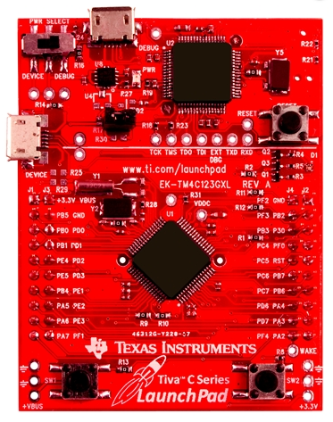
Microcontroller
TM4C123GH6PM - TI Tiva C Launchpad
ARM Cortex M4
80 MHz Clock
16 PWM Outputs
8 UART Modules
USB Programming/Power
Familiarity

Slide 9
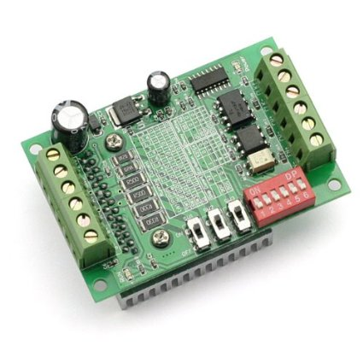
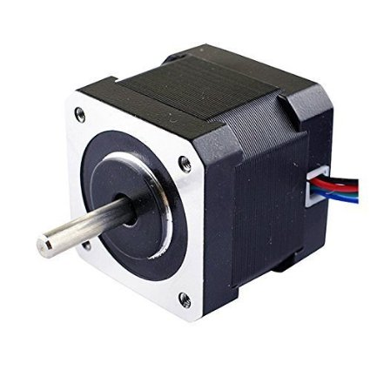
Stepper Motors & Driver
Input: 2A
Holding Torque: 0.45Nm
200 Steps per Revolution
Input: 12-24VDC
Max Output: 3.5 A
Logic Level: 5V
Microstepping for More Accuracy (1, 0.5, 0.25, 0.0625)

Slide 10
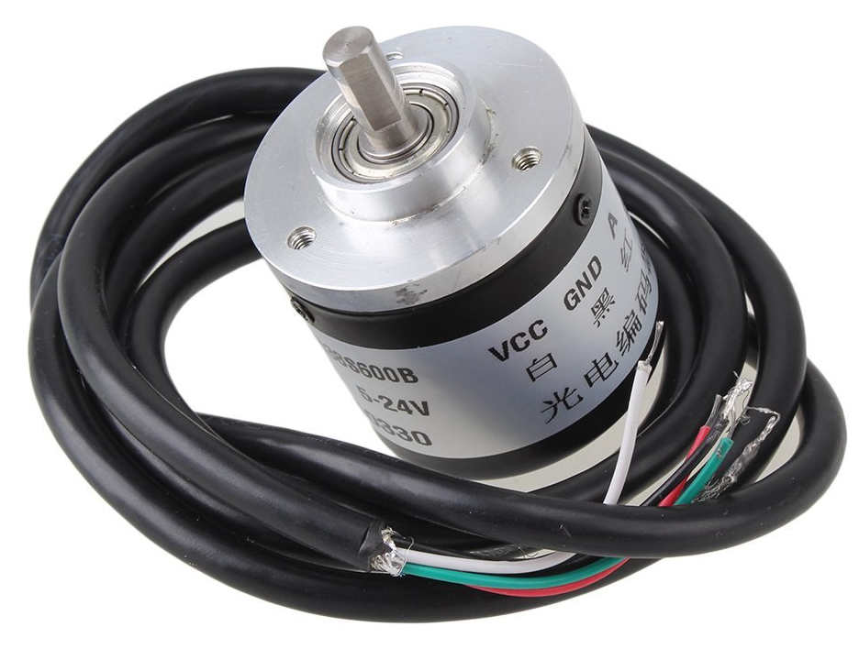
Sensor
Rotary Encoder
Input: 5 – 24 V
Output: 2 phase pulse
Resolution
600 pulses/rev standard
2400 pulses/rev quadrature

Slide 11
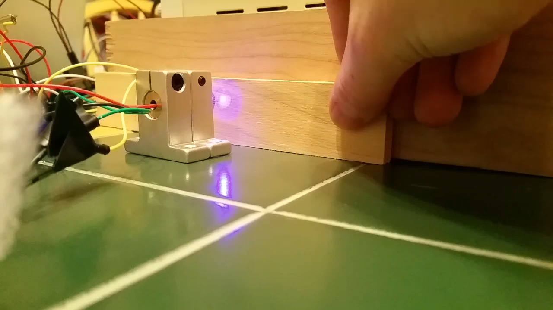
Laser System
2 W, 445 nm Laser
Input: 0 – 5 V, 1 – 1.7 A
FlexMod p3 Laser Driver
Input: PWM
Output: 0-5 V, 1 – 1.7 A

Slide 12
Mechanical Control System
Gantry Type | Standard | Modified | H-Bot | Core-XY | Lead Screws
Carriage (mass) | 2 | 2 | 3 | 3 | 3
Carriage (Complexity) | 2 | 2 | 2 | 3 | 3
Number of Wheels (Complexity) | 3 | 1 | 3 | 2 | 3
Movement Control (Complexity) | 3 | 3 | 2 | 2 | 3
Backlash Risk | 3 | 3 | 3 | 3 | 1
Potential Alignment Risks | 1 | 3 | 2 | 3 | 2
Tracking Speed | 3 | 3 | 3 | 3 | 1
Price (Components) | 3 | 3 | 3 | 3 | 1
Total | 20 | 20 | 21 | 22 | 17
3 is best, 1 is worst

Slide 13
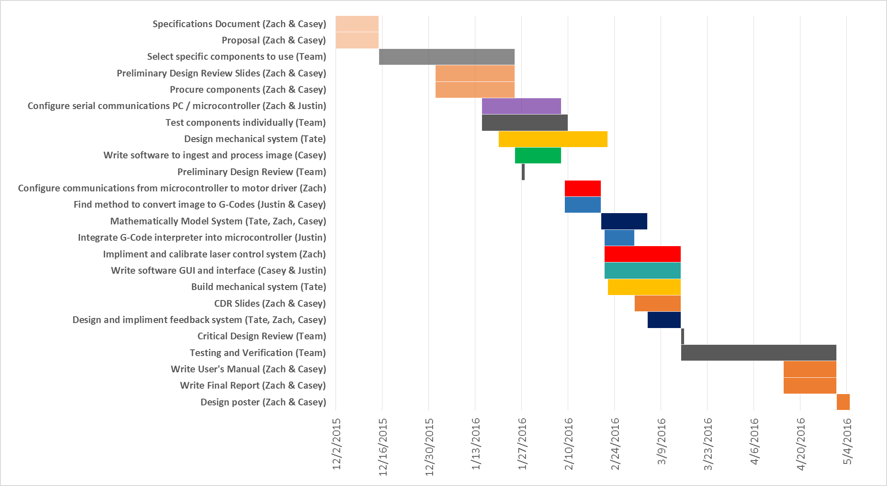
Adjusted Schedule

Slide 14
Budget
Part | Price
Laser Diode | $70
Laser Driver | $50
Motors | $35
Encoder | $35
Motor Drivers | $30
Microcontroller | $15
Mechanical Structure | $130
Cabling, testing material | $35
Total | $400

Slide 15
Conclusion
Current Progress:
Successfully testing and calibrating individual components
Writing image processing / g-code conversion software
Designing structure
Foreseen Challenges:
Structure implementation
Pixel shade control
Long engraving times

Slide 16
Questions?

Slide 17
Appendix

Slide 18
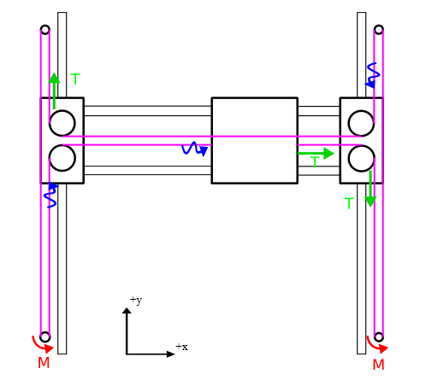
H-Bot
Pros: light weight, clean approach, few rotating wheels, Belts avoid backlash
Cons: potential misalignments due to a moment about the carriage. Controlling two motors simultaneously

Slide 19
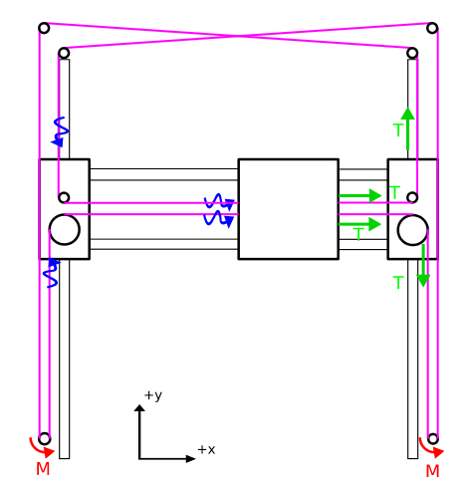
Core-XY
Pros: light weight design, clean approach, belts avoid backlash, no moment about the carriage
Cons: more wheels than the H-BOT. Controlling 2 motors simultaneously

Slide 20
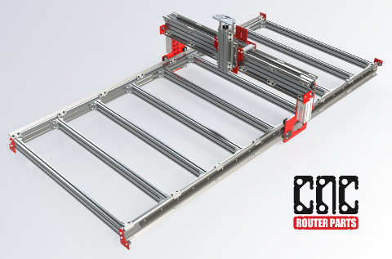
Standard (one motor per axis)
Pros: Simple system.
Cons: has an inherent risk of generating a moment when arranged in simplest form

Slide 21
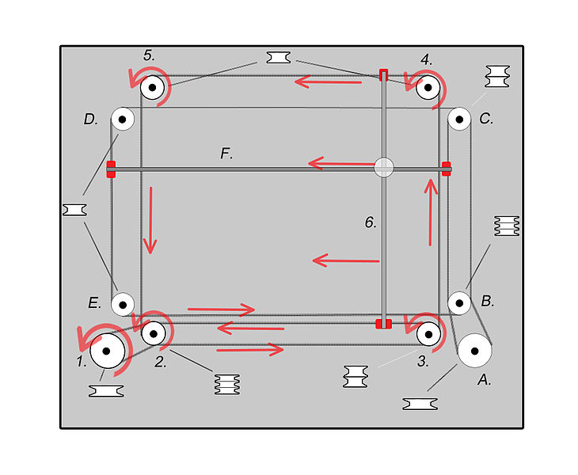
Modified Standard (alternate routing)
Pros: avoid a moment thus providing better movement: each motor controls completely separate direction of movement. Simpler than H-BOT and CORE-XY
Cons: additional complexity than Standard.

Slide 22
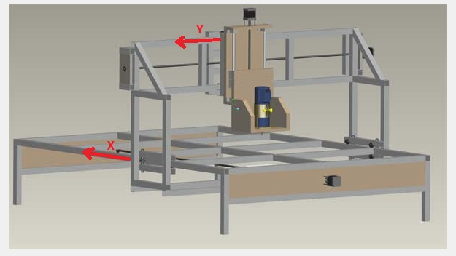
Lead/Ball Screw
Pro: Very simple design, each motor controls movement separately.
Con: Price, backlash. Slower tracking.

